Slide 1

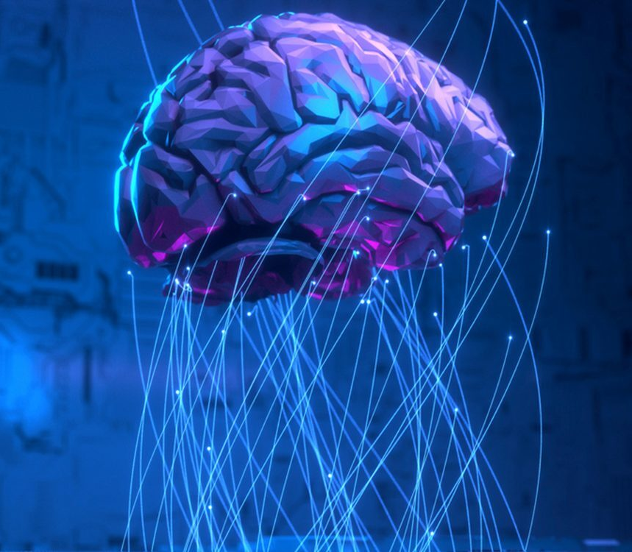
Operating Systems
Designed by Mr. M Mudassar
This Photo by Unknown Author is licensed under CC BY-NC-ND

Slide 2
Outline
Process
Threads
CPU Scheduling
Process Synchronization
Deadlocks
Memory Management
Virtual Memory
File System
I/O System
Disk Management
Protection
Security

Slide 3
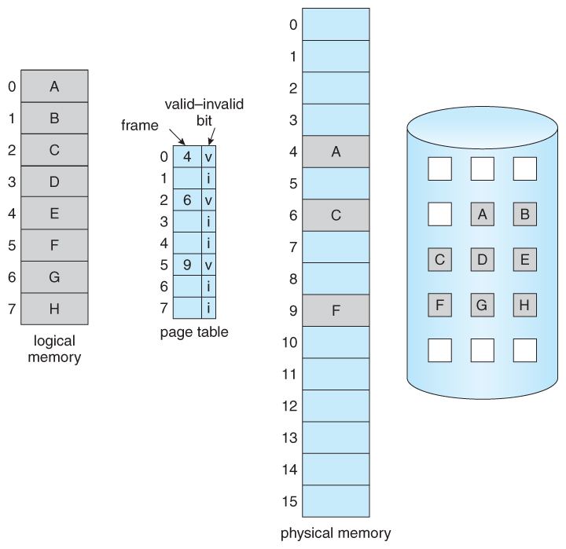
Virtual Memory

Slide 4
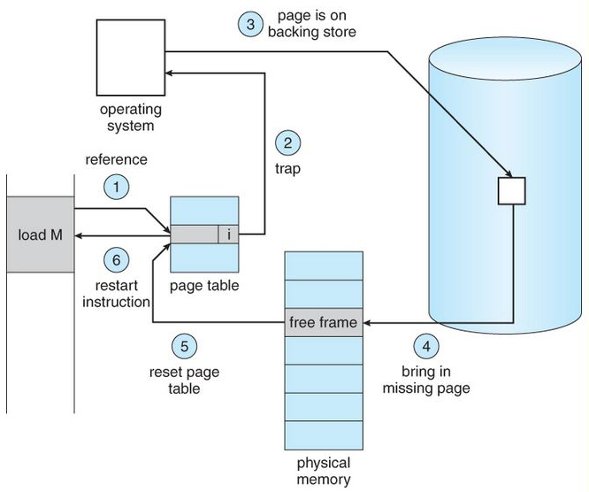
Page Fault

Slide 5

Virtual Memory – Advantages
Page will be brought into the memory only when it is needed.
Less I/O needed
Less memory needed
Faster response
More users
Page is needed → Reference to it
Invalid reference → abort it
Not in memory → bring to memory

Slide 6
Performance of Demand Paging
0 ≤ Page Fault Probability (P) ≤ 1
Effective Access Time (EAT)
EAT = [(1 – P) * memory access] + [(P) * (Page Fault Overhead)]
Page Fault Overhead may involve
Swap page out
Swap page in
Restart overhead

Slide 7
Performance of Demand Paging
Given
If the memory access time = 200 ns
Average page fault service time = 8 ms
1 access out of 1000 causes a page fault
Solution
EAT = [(1 – P) * 200] + [P * 8,000,000]
EAT = [(1 – 0.001) * 200] + [0.001 * 8,000,000]
EAT = 8.2 μs

Slide 8
Page Replacement Algorithms
FIFO Page Replacement Algorithm
Optimal Page Replacement Algorithm
LRU Page Replacement Algorithm

Slide 9
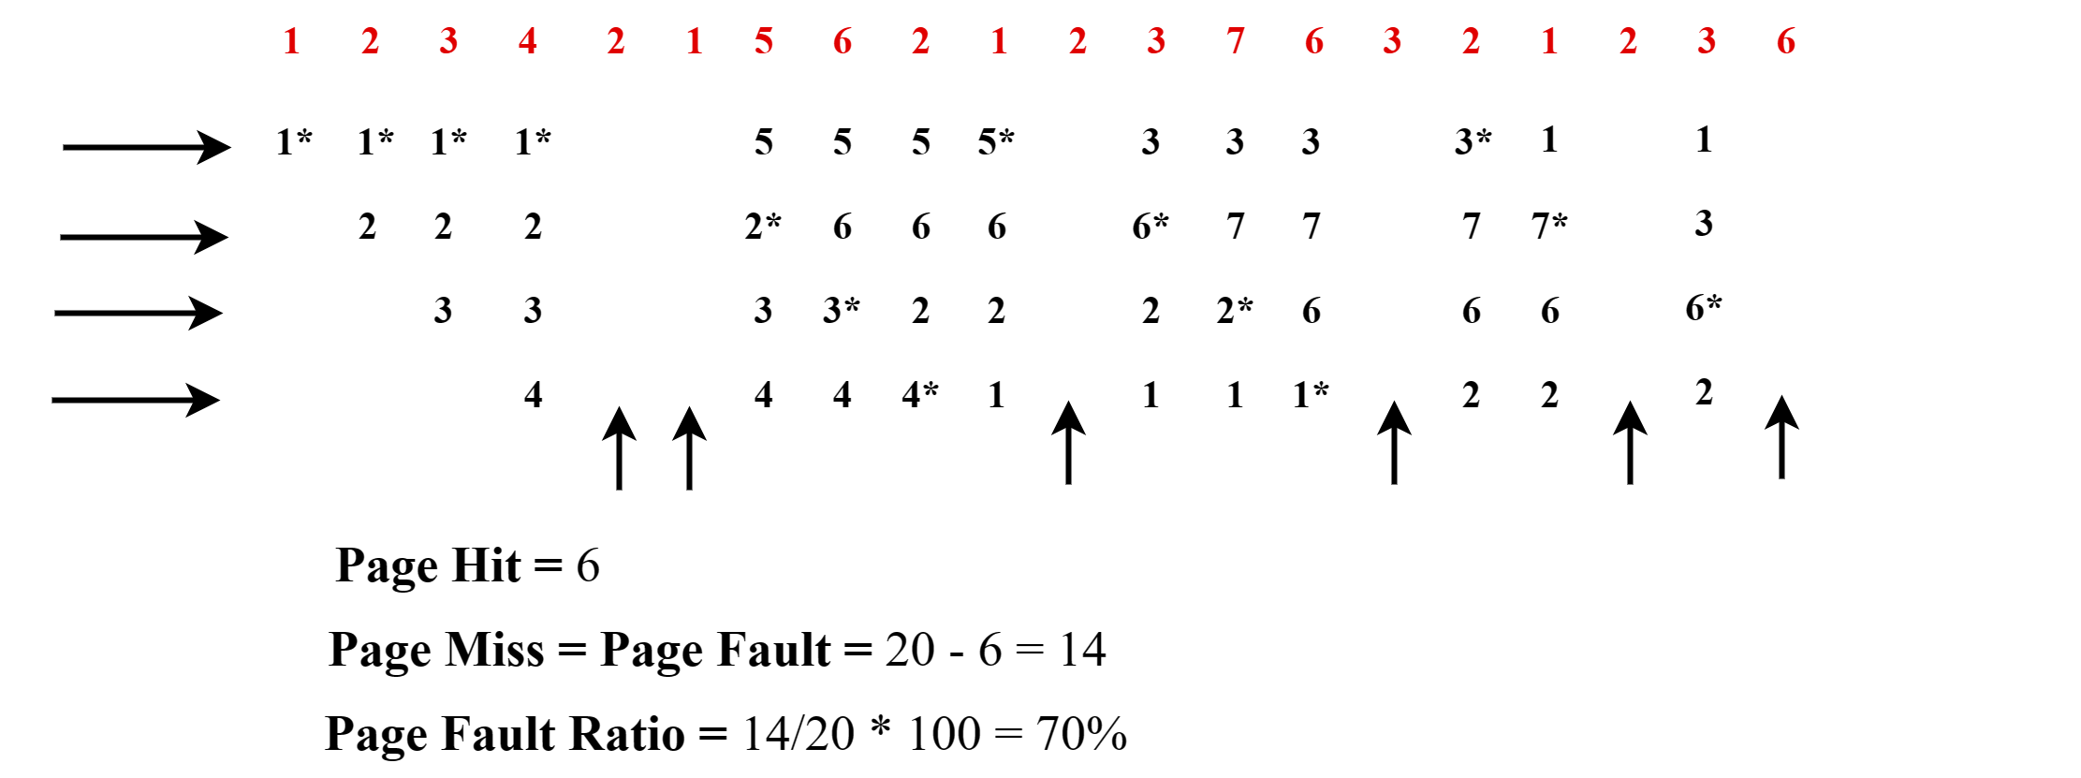
FIFO Page Replacement Algorithm
Page fault = Total pages – Hit - [Replace the page that first comes in.]

Slide 10
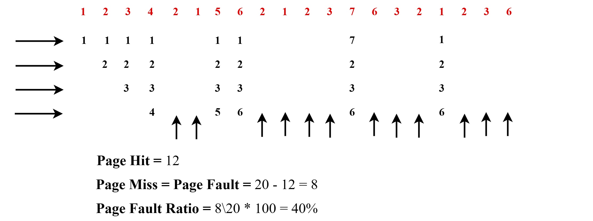
Optimal Page Replacement Algorithm
Page fault = Total pages – Hit - [Replace the page that will not be used for the longest time.]

Slide 11

LRU Page Replacement Algorithm
Page fault = Total pages – Hit [Least Recently Used]

Slide 12
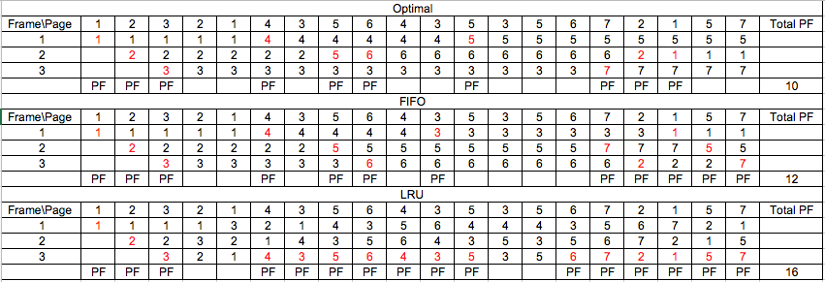
Page Replacement Algorithms
Page fault = Total pages – Hit

Slide 13
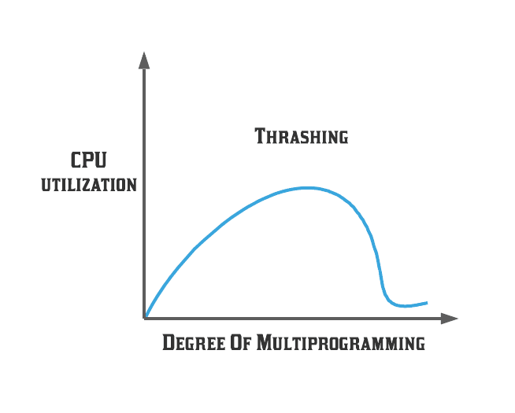
Thrashing
High Page Fault Rate
Drastically reduction of the CPU utilization

Slide 14
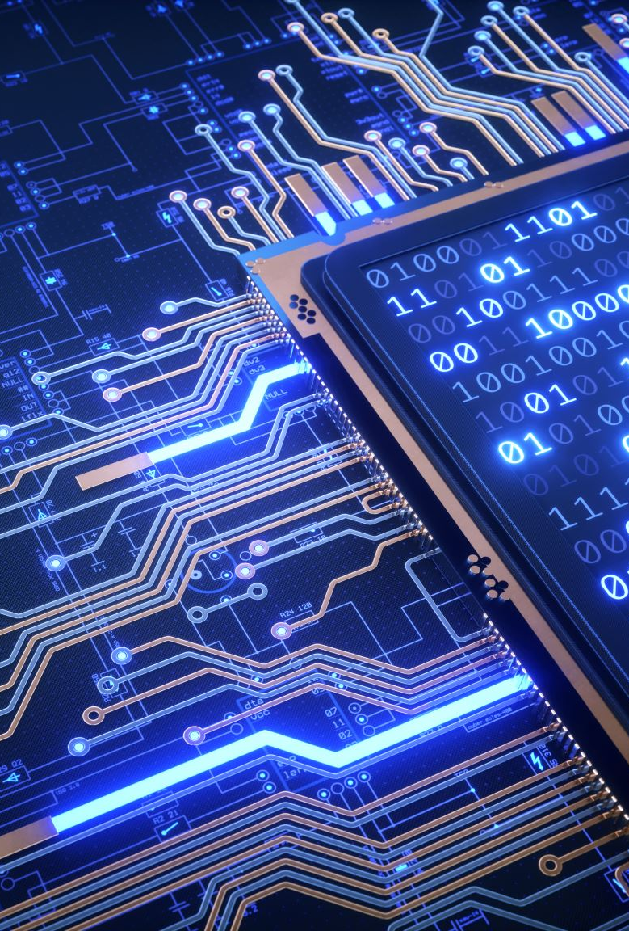
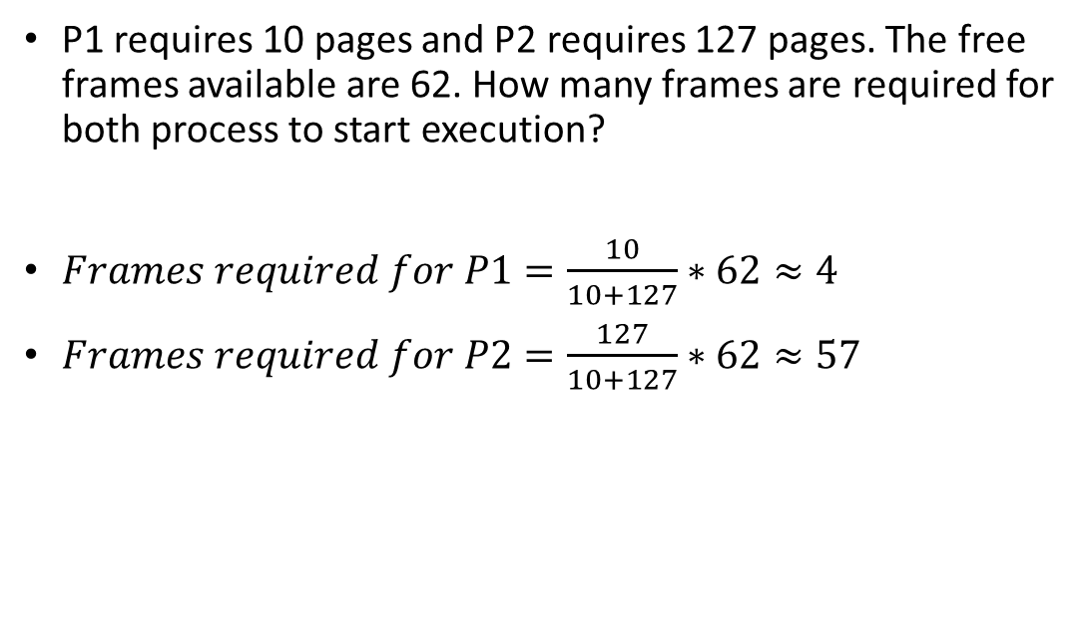
Allocation Algorithms
P1 requires 10 pages and P2 requires 127 pages. The free frames available are 62. How many frames are required for both process to start execution?
$Frames required for P1=\frac{10}{10+127}∗62≈4$
$Frames required for P2=\frac{127}{10+127}∗62≈57$

Slide 15

References
https://youtu.be/Ob4PUQRBSLE
https://youtu.be/I83cu__pBSA
https://youtu.be/xoE-DZQhqKI
https://youtu.be/uvUelUPzaPU
https://youtu.be/uqnWm7ga5wA
https://youtu.be/1JtIdbp-a-Y
https://youtu.be/7pP1ZRPenYA
https://youtu.be/rLtVffqpQdY

Slide 16
Thank You(Q & A)

